Slide 1
REMOTE INFRASTRUCTURE MANAGEMENT
S. PAVITHRADEVI B.E., M.TECH,

Slide 2
INTRODUCTION
Monitoring and managing all elements of enterprise infrastructure and resolving any issues from remote locations.
Enabling continuous availability - onsite repairs and maintenance are required only in cases of hardware failure.
SERVICES : Desktop management , DB management , N/W management , storage , remote staff augmentation.
Monitor -> manage -> troubleshoot
Eg : Solarwinds , Connectwise Automate, teamviewer , AnyDesk , Remote Desktop protocol, Puppet , Ansible, Cisco network Assistant, Netflow, Firewall, Antivirus S/W..etc.,.

Slide 3
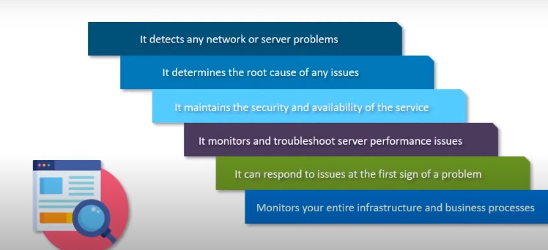
WHY CONTINUOUS MONITORING?

Slide 4
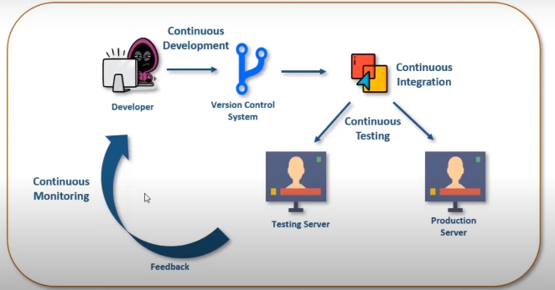
WHAT IS CONTINUOUS MONITORING

Slide 5
Nagios
Monitoring tool, Event monitoring system -offers monitoring and alerting services for servers, switches, applications and services.
Monitor devices running Linux, Windows and Unix OSes.
Software runs periodic checks on critical parameters of application, network and server resources.
Eg : Monitor memory , disk use , processor load , currently running processes, services like SMTP, POP3, HTTP, common network protocol.

Slide 6
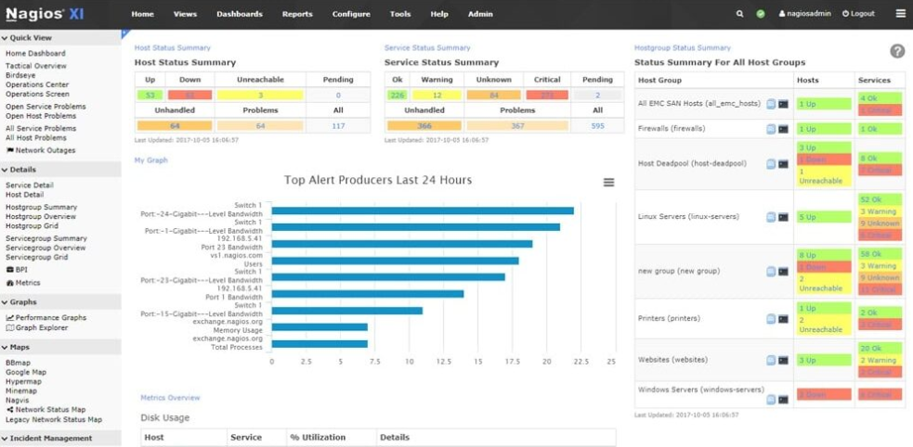


NAGIOS ARCHITECTURE
NRPE PLUGIN
SCHEDULER
Clients don’t have plugin installed. Log data of clients are sent through plugins

Slide 7
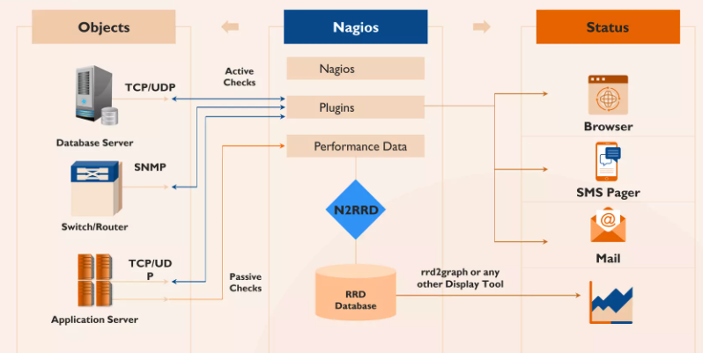
WORKFLOW

Slide 8
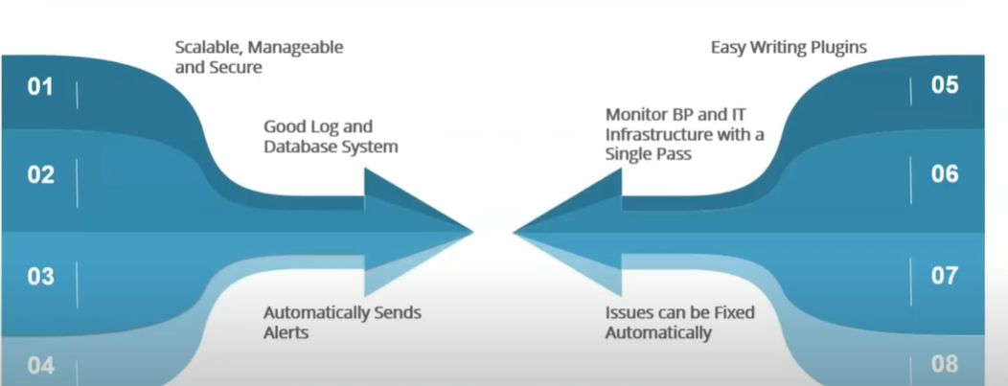
FEATURES
Detects N/W error and server crashes
Support for implementing redundant monitoring host

Slide 9
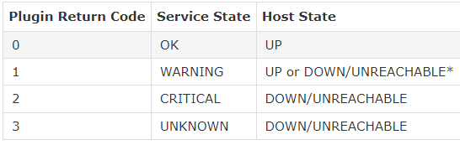
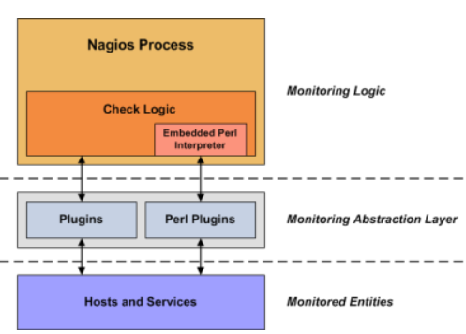
NAGIOS PLUGINS
compiled executables or scripts (Perl scripts, shell scripts, Python, PHP, Ruby, etc.) that can be run from a command line to check the status or a host or service. Nagios Core will execute a plugin whenever there is a need to check the status of a service or host. The plugin does something (notice the very general term) to perform the check and then simply returns the results to Nagios Core. Nagios Core will process the results that it receives from the plugin and take any necessary actions (running event handlers, sending out notifications, etc).
Eg:
check_snmp_printer
check_snmp_css.pl

Slide 10
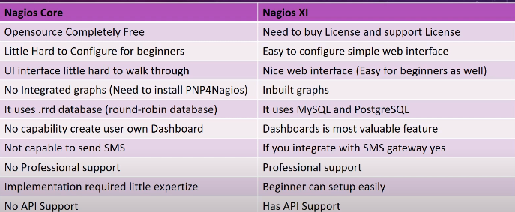

Slide 11
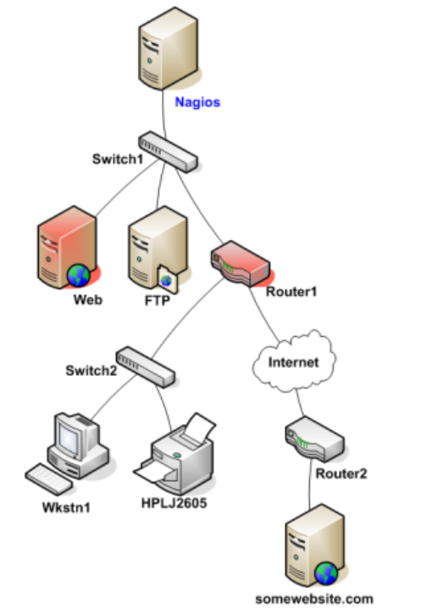
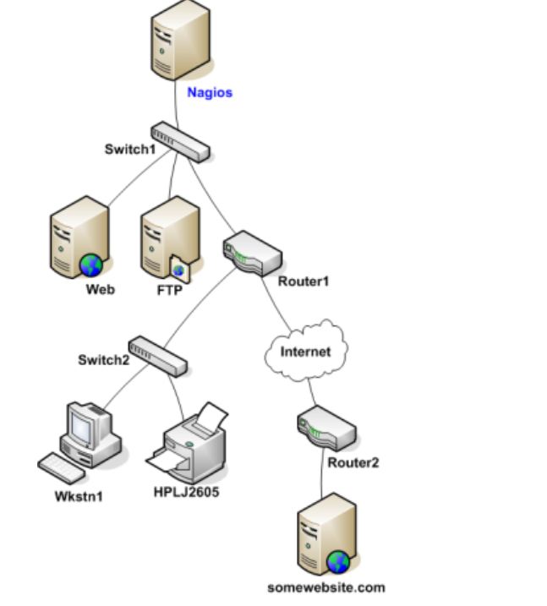
PARENT/CHILD RELATIONSHIP

Slide 12
INSTALLATION
Download .OVA file from website
Open virtual machine
Import .OVA file
Login with credential
Copy IP in browser
Create password

Slide 13
TERMINOLOGY
PLUGIN
USER
CONTACTS
CONTACTS GROUP
HOST
SERVICE
ACKNOWLEDGEMENT
DOWNTIME
LATENCY
STATE
AGENT
HOST GROUP

Slide 14
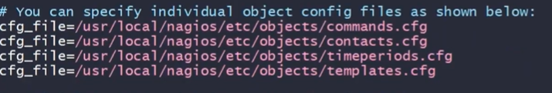
OBJECT – VARIOUS ELEMENT OF MONITORING
Keep the following in mind:
#' character are taken to be comments
Directive names are case-sensitive
(;) in configuration lines are treated as comments
include_file=<file_name>
include_dir=<directory_name>

Slide 15
OBJECT TYPE
HOST definition
Host Group definition
Service definition
Service Group definition
Contact definition
Contact group definition
Time period definition
Command definition
Service/Host dependency definition
Service/Host escalation definition
Extended host/service information

Slide 16
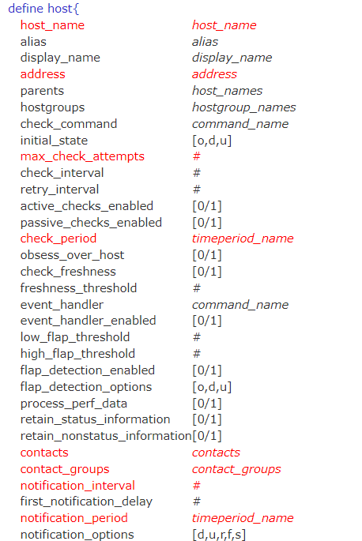
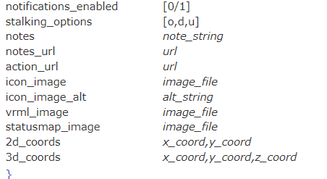





HOST DEFINITION
RETENTION NOTE

Slide 17
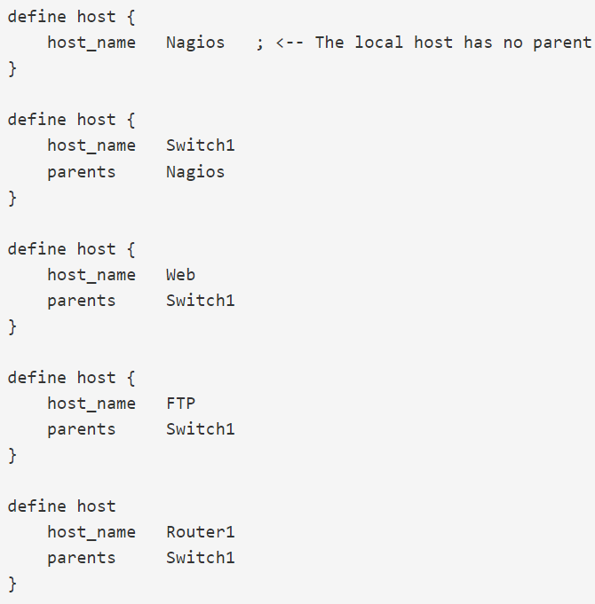
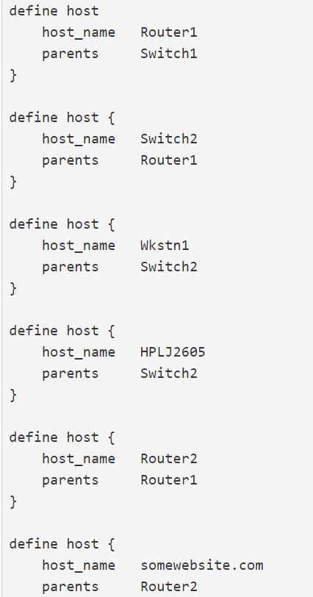
HOST DEFINITION FOR ABOVE EXAMPLE

Slide 18
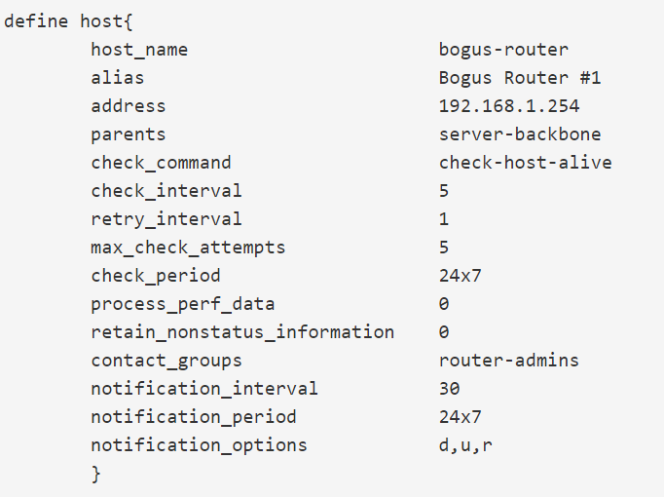
EXAMPLE OF HOST DEFINITION

Slide 19
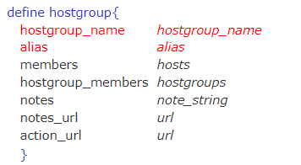
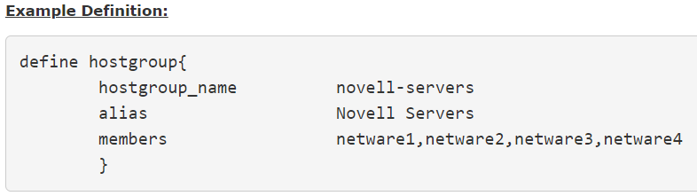
HOST GROUP DEFINITON

Slide 20
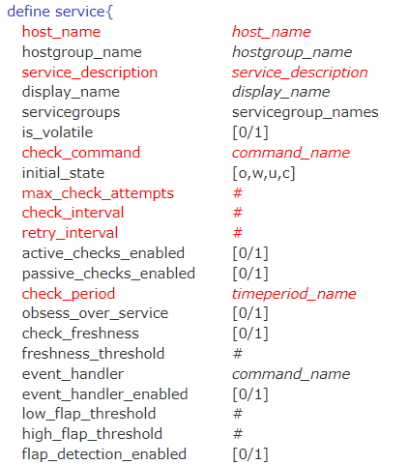
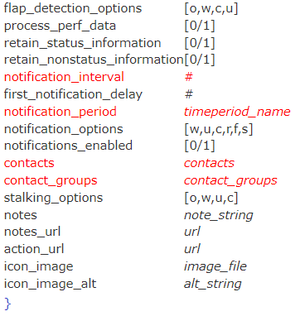
SERVICE DEFINITION

Slide 21
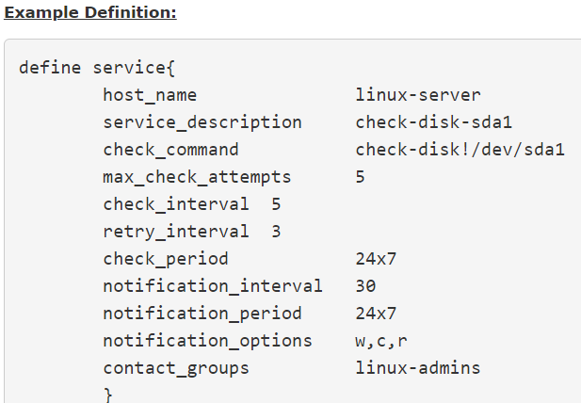
SERVICE DEFINITION

Slide 22
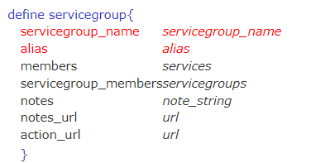
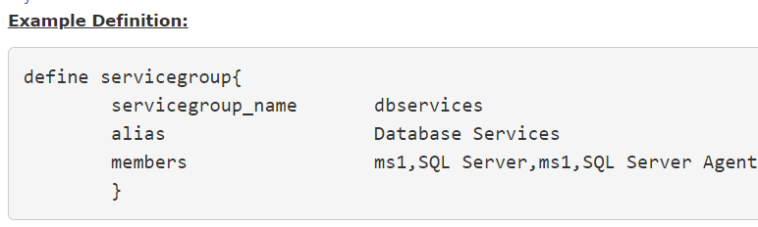
SERVICE GROUP DEFINITION

Slide 23
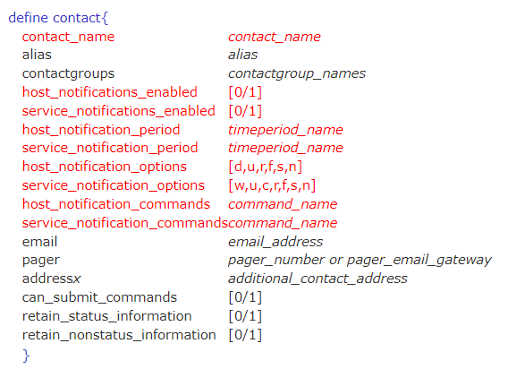
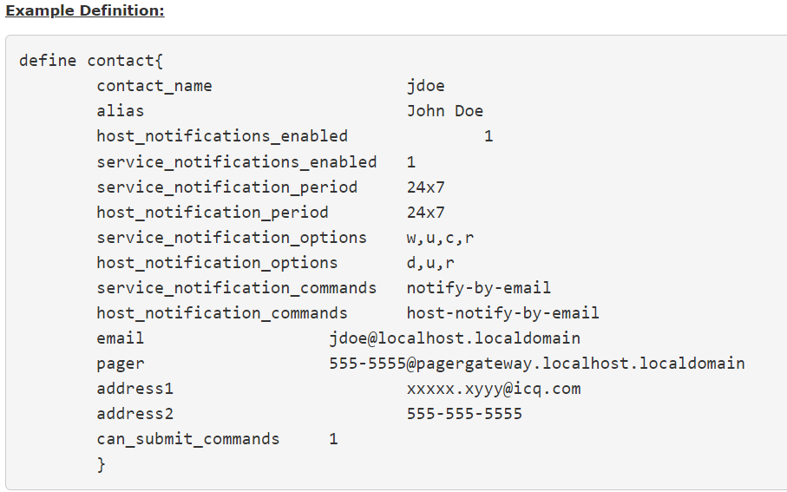
CONTACT DEFINITION

Slide 24
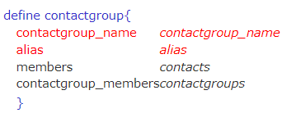
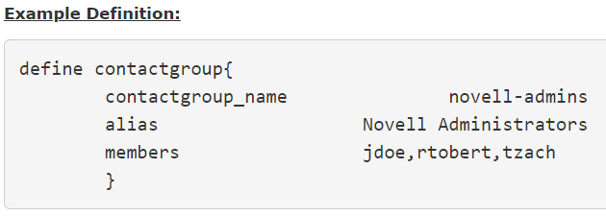
CONTACT GROUP DEFINITION

Slide 25
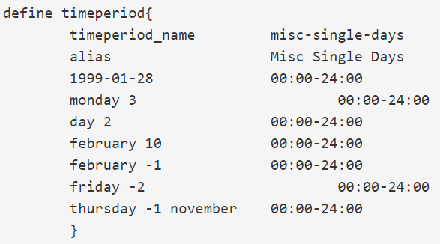
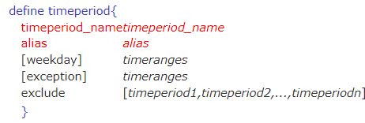
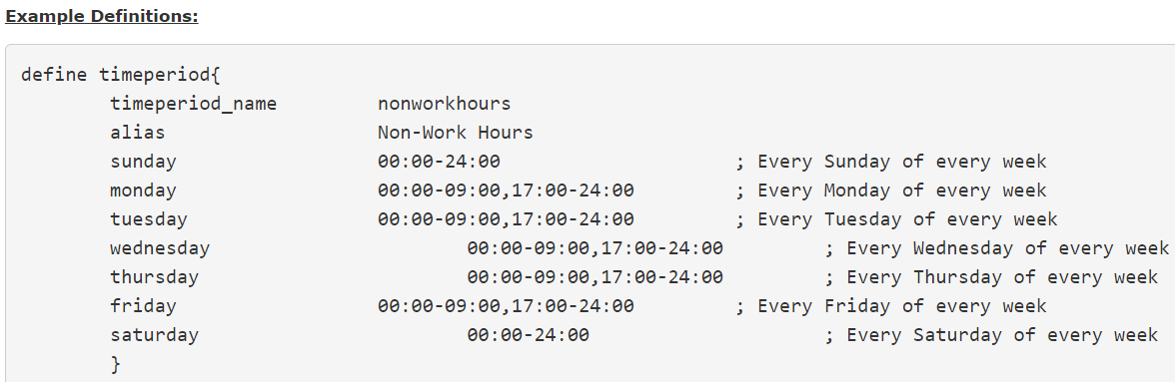
TIME PERIOD DEFINITION

Slide 26

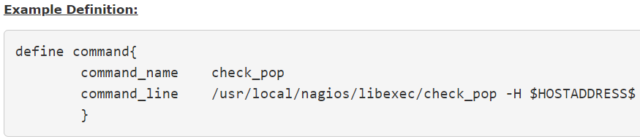
COMMAND DEFINITION

Slide 27
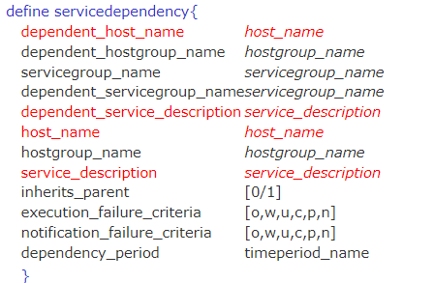
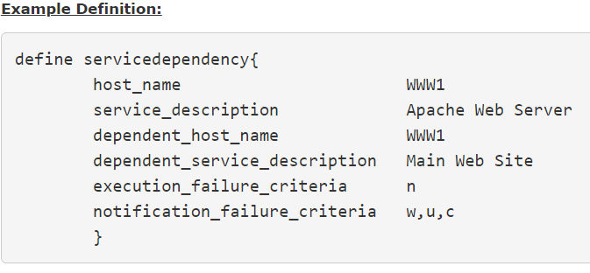
SERVICE DEPENDENCY DEFINITION

Slide 28
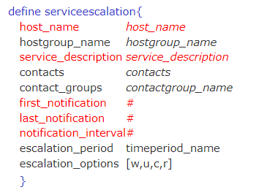
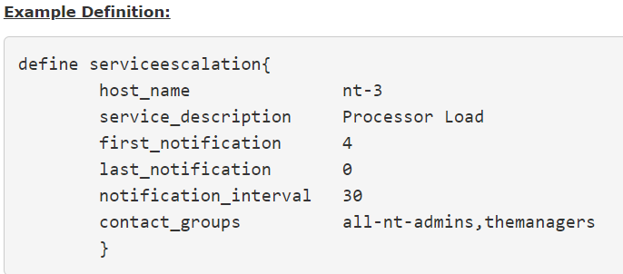
SERVICE ESCALATION

Slide 29
REACHABILITY LOGIC

Slide 30
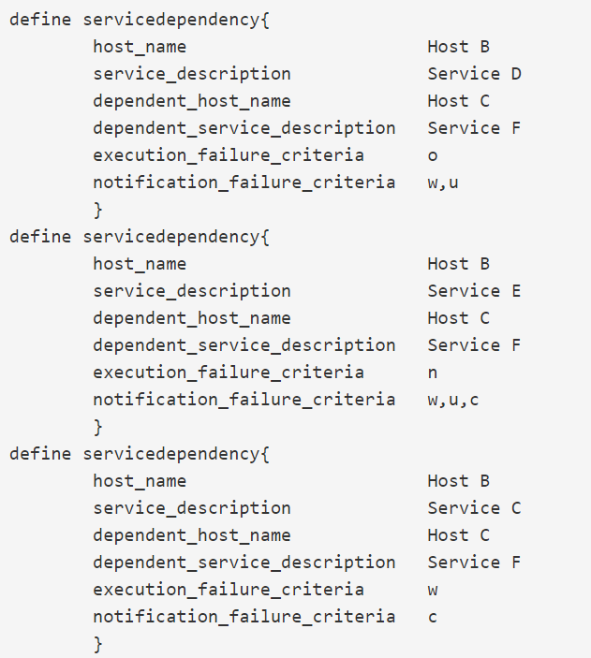
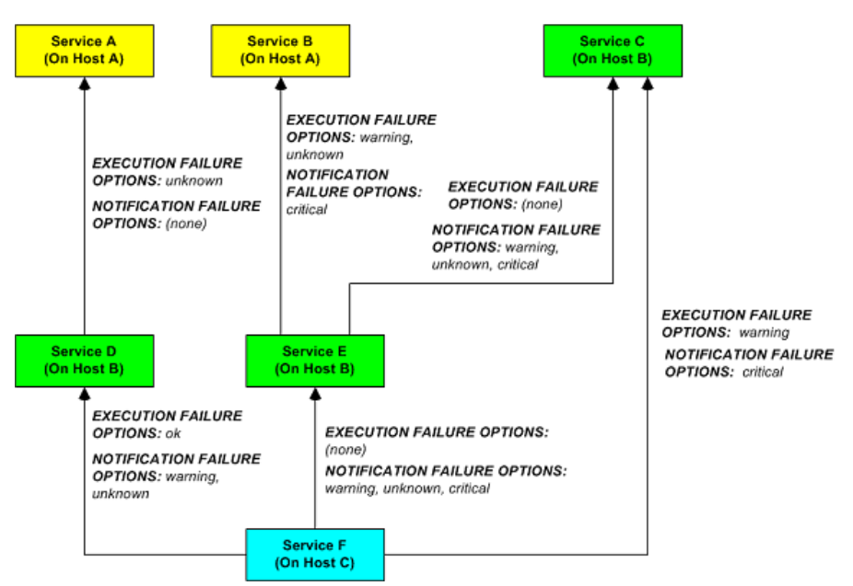
SERVICE DEPENDENCY

Slide 31
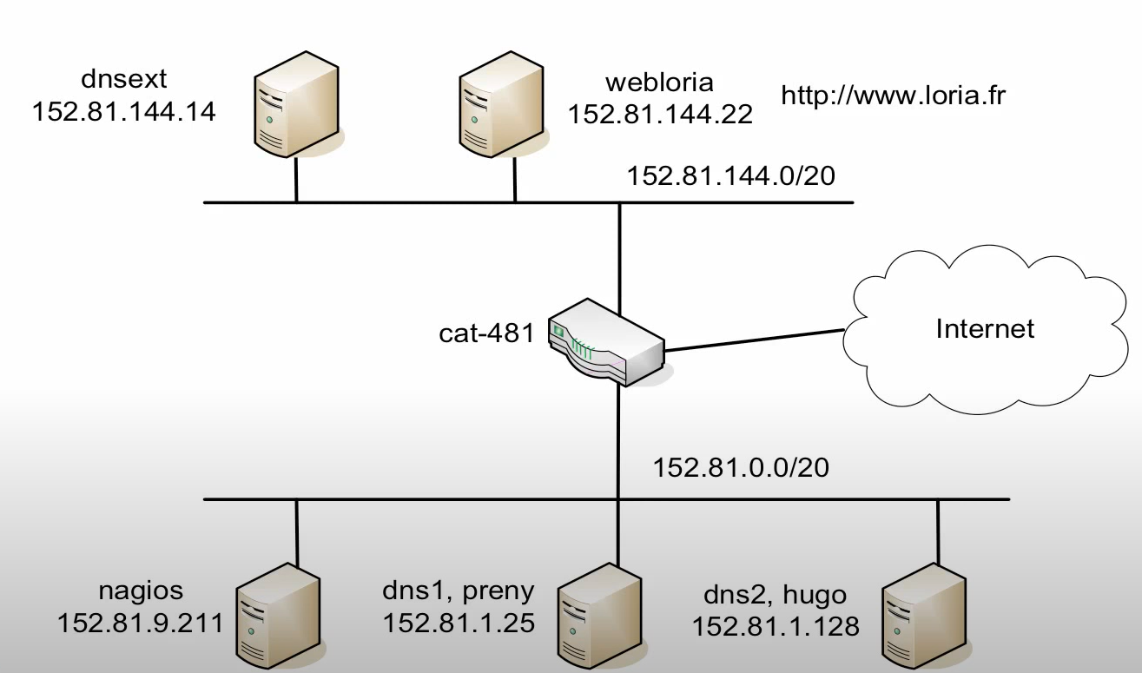
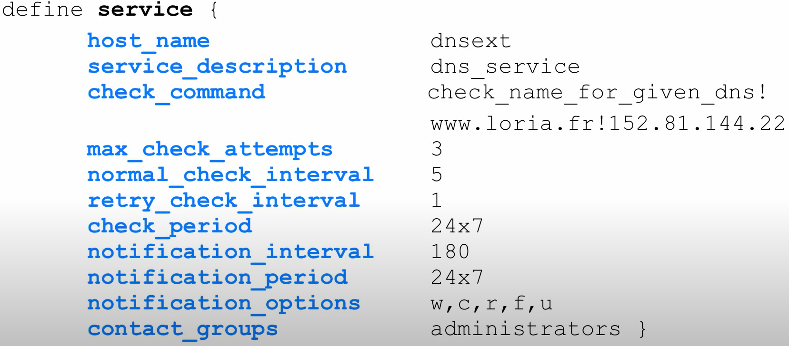
USE CASE - OBJECT

Slide 32
TRY IT…
Try to define the service(http_service) for web server – subnetwork 1.
The following check and notification is executed for 24x7.
Normal interval for active check is 5 min and the notification has to be sent for Warning, critical, recovery, flapping, unknown state for every 3 hrs.
If Non OK state occur - Retry for maximum attempt of 4 at the interval of 1 min.

Slide 33
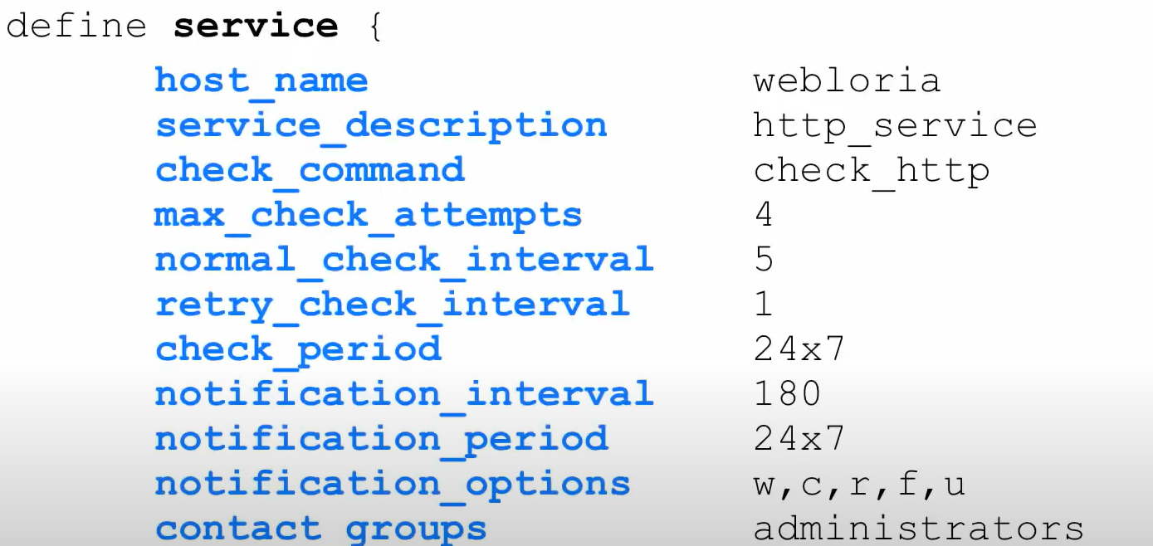
SERVICE DEFINING – WEB SERVER

Slide 34
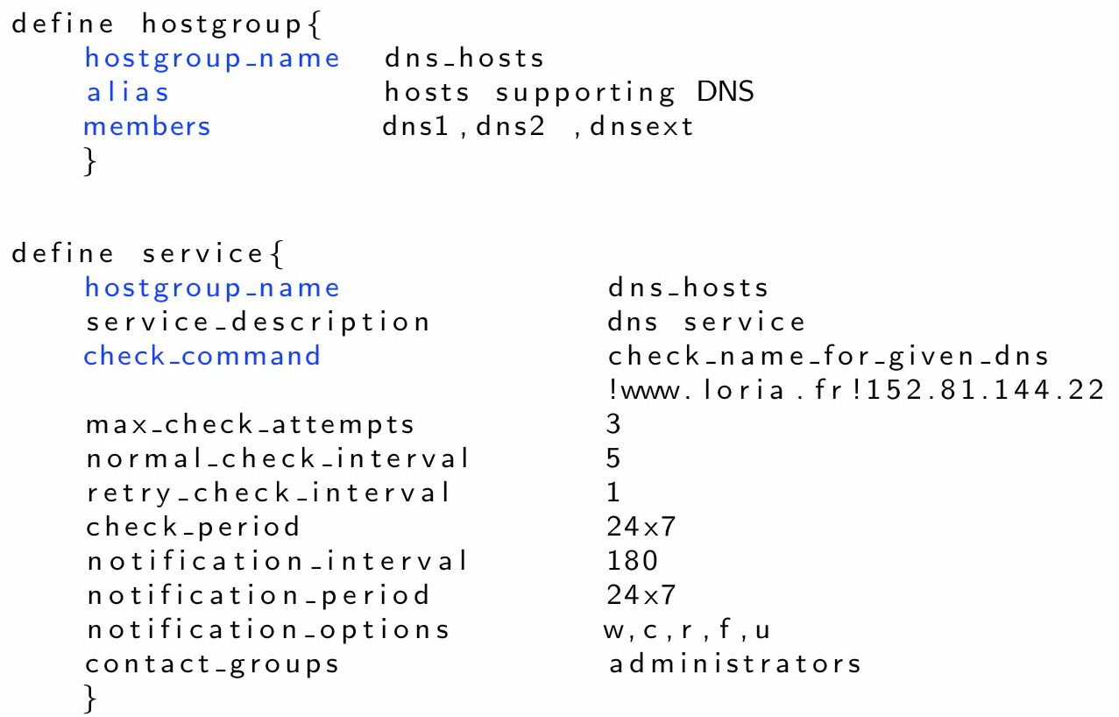
HOST , SERVICE GROUP

Slide 35
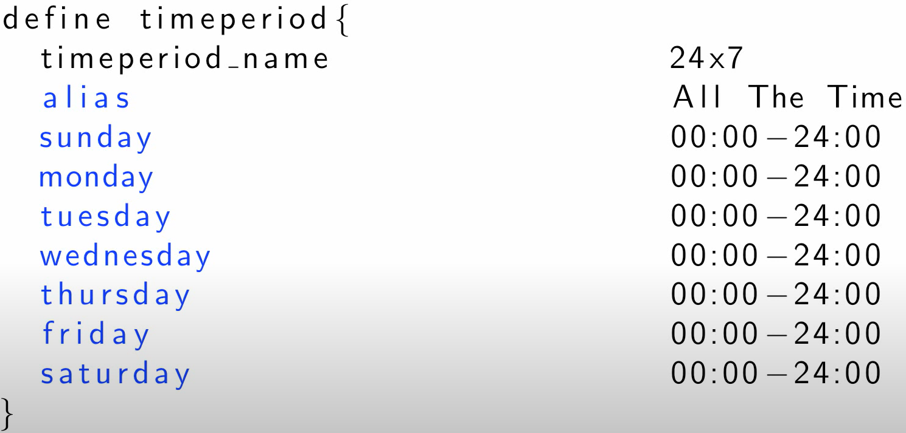
TIME PERIOD

Slide 36
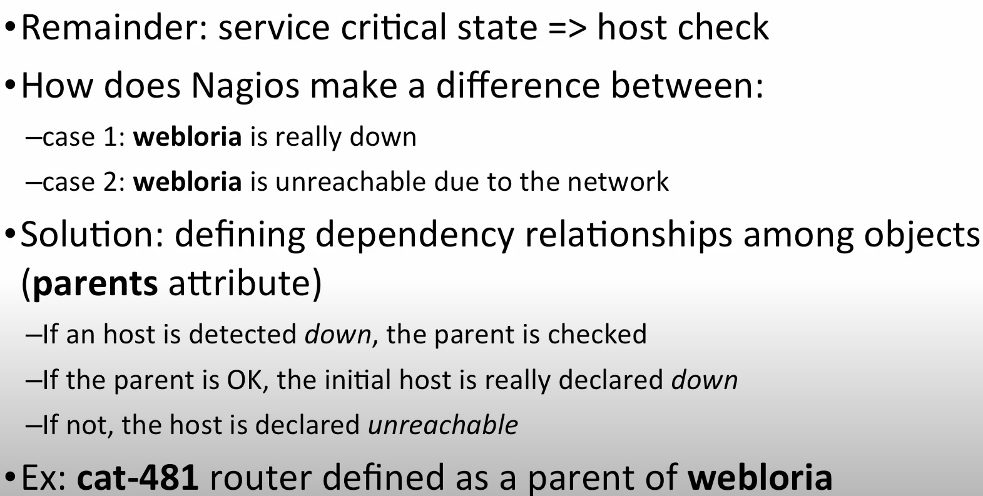
SPECIFYING DEPENDENCY

Slide 37
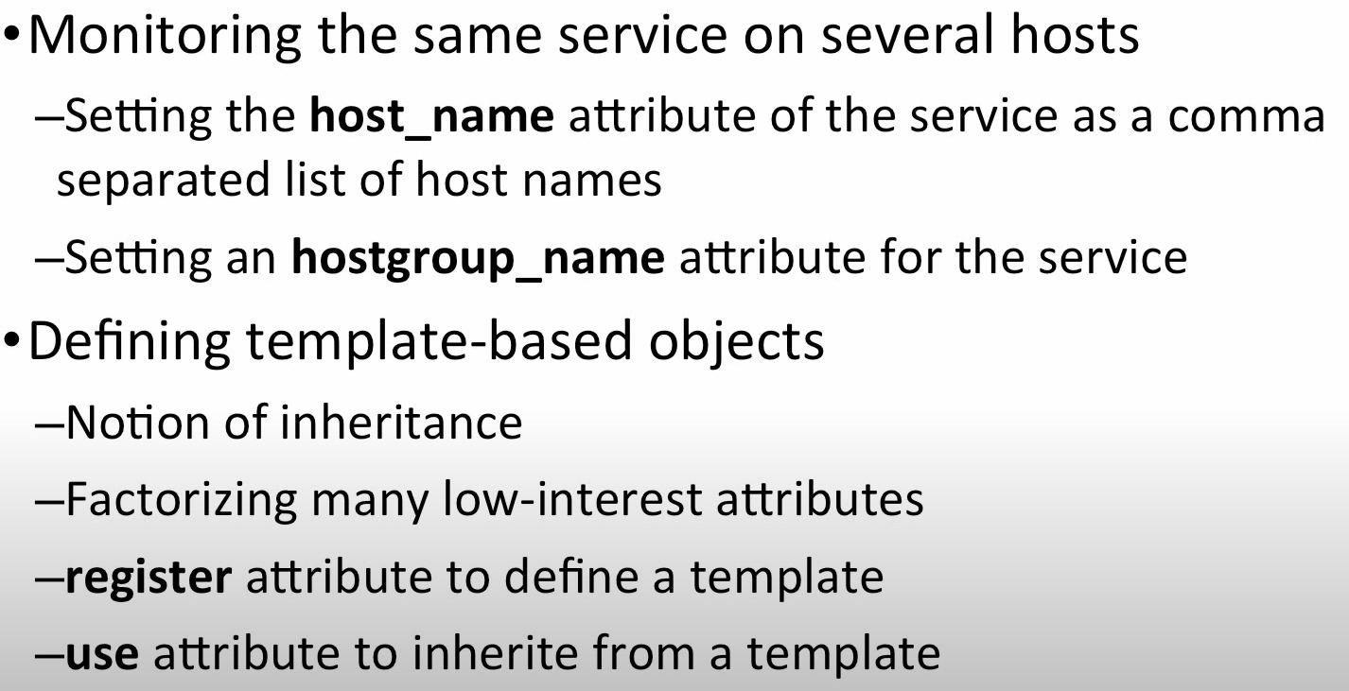
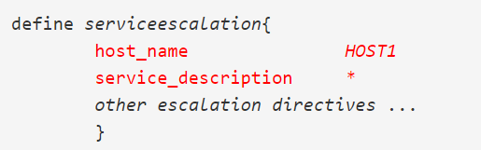
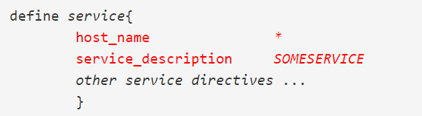
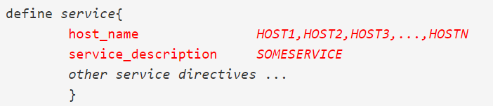
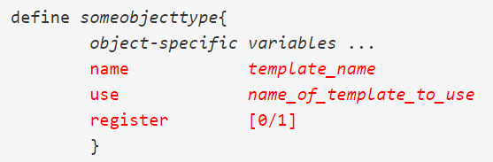
MAKING CONFIGURATION SIMPLE

Slide 38
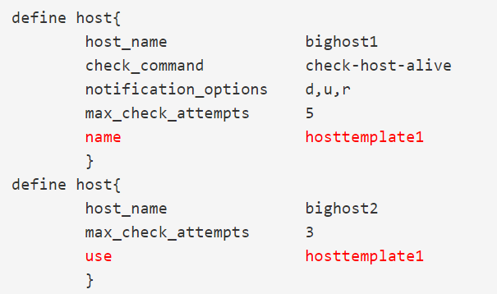
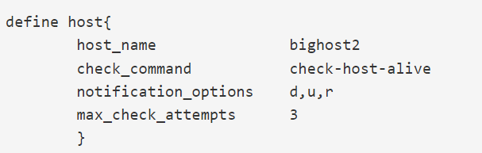
OBJECT INHERITANCE

Slide 39




ACTIVE Vs PASSIVE
ACTIVE CHECK EXECUTED AT,
check_interval, retry_interval
On-demand as needed
ACTIVE CHECK

Slide 40

PREDECTIVE DEPENDENCY CHECK
COMMAND
enable_predictive_host_dependency_checks
enable_predictive_service_dependency_checks

Slide 41

ACTIVE VS PASSIVE

Slide 42

USE CASES

Slide 43

ENABLING PASSIVE CHECK

Slide 44

NRDP – SERVER SIDE

Slide 45

NRDP-CLIENT SIDE

Slide 46

VOLATILITY

Slide 47

VOLATILITY

Slide 48

STATE STALKING

Slide 49

STATE STALKING

Slide 50

STATE STALKING

Slide 51

FRESHNESS

Slide 52

FRESHNESS

Slide 53

EX-1:AIRPLANE CALL BUTTON

Slide 54

EXAMPLE 1

Slide 55

EXAMPLE 1

Slide 56

EXAMPLE 1

Slide 57

EXAMPLE 2 : BACKUP MONITORING

Slide 58

EXAMPLE 2

Slide 59

EXAMPLE 2

Slide 60

EXAMPLE 2

Slide 61

SAMPLE OUTPUT OF AIRPLANE CALL BUTTON

Slide 62

OTHER CASES:

Slide 63
SOFT STATE
check results - non-UP or non-OK state - NO (re)check the number of times (max_check_attempts)
log_service_retries or log_host_retries

Slide 64
HARD STATE - $SERVICESTATETYPE$, $HOSTSTATETYPE$
check results - non-UP or non-OK state -(re)checked the number of times (max_check_attempts)
One hard error state to another (e.g. WARNING to CRITICAL).
Check results in a non-OK state, corresponding host is either DOWN or UNREACHABLE.
passive host check is received, treated as HARD, passive_host_checks_are_soft=1
CHANAGES IN HOST/SERVICES:
HARD state is logged.
Event handlers are executed to handle the HARD state.
Contacts are notified of the host or service problem or recovery.

Slide 65

STATE - max_check_attempts = 3

Slide 66


EXAMPLE

Slide 67


Slide 68


Slide 69

SERVICE STATE DIAGRAM

Slide 70

LOCAL CHECK

Slide 71

REMOTE CHECK

Slide 72

USING NOTIFICATION ESCALATION

Slide 73




MACROS
Macros allow you to reference information from hosts, services, and other sources in your commands.
SYNTAX
DIRECTORY

Slide 74
$USER1$=/usr/local/nagios/libexec
EXAMPLE: $USER1$/check_http -H $HOSTADDRESS$
MAX NO - 256.
USER MACROS – Can update .cfg file within CCM
SYSTEM MACROS - inherited from object definitions

Slide 75

Host Address Macro

Slide 76

Command Argument Macros

Slide 77


Command Argument Macros

Slide 78
MACROS VALIDITY
Service checks
Service notifications
Host checks
Host notifications
Service event handlers and/or a global service event handler
Host event handlers and/or a global host event handler
OCSP command
OCHP command
Service performance data commands
Host performance data commands

Slide 79
HOST MACROS
$HOSTNAME$
$HOSTALIAS$
$HOSTALIAS$
$HOSTCHECKCOMMAND$
$HOSTATTEMPT$
$HOSTPERFDATA$

Slide 80
ON-DEMAND MACROS
$HOSTMACRONAME:host_name$
$SERVICEMACRONAME:host_name:service_description$
Replace HOSTMACRONAME and SERVICEMACRONAME with the name of one of the standard host of service macros
Separated from the host or service identifier by a colon (:)

Slide 81


ON-DEMAND GROUP MACROS
$HOSTMACRONAME:hostgroup_name:delimiter$
$SERVICEMACRONAME:servicegroup_name:delimiter$
$CONTACTMACRONAME:contactgroup_name:delimiter$

Slide 82
CUSTOM OBJECT VARIABLE
Begin with an underscore (_) to prevent name collision with standard variables.
Converted to all uppercase before use.
Inheritable from object templates like normal variables
Scripts can reference custom variable values with macros and environment variables.

Slide 83



EXAMPLE

Slide 84

Custom Variables As Macros

Slide 85

CUSTOM VARIABLE MACROS
$_HOSTvarname$
$_SERVICEvarname$
$_CONTACTvarname$
$_HOSTMACADDRESS$
Macros-environment variables for easy reference by scripts or commands .
$USERn$ and "on-demand" host and service macros are not made available as environment variables.
$HOSTNAME$ - "NAGIOS_HOSTNAME".

Slide 86
SYSTEM MACRO - their values are inherited from object definitions
$HOSTADDRESS$
$ARG1$
$HOSTSTATE$

Slide 87


CONFIGURATION

Slide 88

Edit User Macros
AFTER UPDATING:
CCM > Tools > Config File Management > Restart Nagios Core.

Slide 89

SYSTEM MACROS

Slide 90




CREATE NEW USER MACRO

Slide 91
EVENT HANDLER
Restarting a failed service
Entering a trouble ticket into a helpdesk system
Logging event information to a database
Is in a SOFT problem state
Initially goes into a HARD problem state
Initially recovers from a SOFT or HARD problem state

Slide 92
Event Handler Types
Global host event handler
Global service event handler
Host-specific event handlers
Service-specific event handlers
COMMANDS
global_host_event_handler
global_service_event_handler
enable_event_handlers

Slide 93
Writing Event Handler Commands
For Services: $SERVICESTATE$, $SERVICESTATETYPE$, $SERVICEATTEMPT$
For Hosts: $HOSTSTATE$, $HOSTSTATETYPE$, $HOSTATTEMPT$

Slide 94






INSTALLATION
Installation on Vmware
Installation on Hyper V
Installation on ESXi
Installation on Linux – Ubuntu/ centOS/Debian/RHEL

Slide 95
MONITORING WINDOWS
There are several steps need to follow in order to monitor a new Windows machine.
Installing the NCPA Agent on Windows
Configuring NCPA
Start Monitoring
  Active Checks (check_ncpa.py)
    Installing the check_ncpa.py plugin
    Creating new command, host and service definitions for monitoring the Windows machine
    Restarting the Nagios daemon
  Passive Checks (NRDP)
    Add checks to your ncpa configuration
    Configure your NRDP settings

Slide 96



CONFIGURATION WIZARD

Slide 97
INSTALLATION
INSTALLATION METHOD IN MICROSOFT 365 SLIDES

Slide 98


CAPACITY PLANNING
Admin > System Config > License Information

Slide 99



Slide 100


Slide 101


REPORT
Advanced Options

Slide 102


REDUNDANT MONITORING
Scenario 1
handle-master-host-event
handle-master-proc-event
can minimize time lag: check_interval
and retry_interval high frequency

Slide 103


Service Event Handler (handle-master-proc-event):
Host Event Handler (handle-master-host-event):

Slide 104
FAILOVER MONITORING
Scenario 2
Disable :- execute_service_checks
Enable: check_nrpe (slave), check_nagios(master)
ocsp command - for distributed monitoring

Slide 105


INBOUND, OUTBOUND TRANSFER CHECK
NRDP : PORT – 80
NSCA: PORT - 5667
IN INTERFACE,
Admin > Check Transfers > Inbound Transfers

Slide 106

NRDP TOKEN

Slide 107

NSCA CONFIGURATION
vi /etc/xinetd.d/nsca
XI server and each client using :
• Decryption / encryption method
• Password
only_from = 127.0.0.1 10.25.18.22 10.25.18.23

Slide 108

FIREWALL CONFIGURATION

Slide 109

Nagios Fusion Highlights:
• Expand your monitoring setup by adding more monitoring servers
• Multiple users can be setup to access the Fusion interface
• Users can customize their views and dashboards
• Automatic authentication to distributed Nagios XI servers
• Central dashboard provides overall picture of environment
• Configuration is handled on the distributed (child) servers
• Performance graphing and other I/O intensive tasks are handled by the distributed servers

Slide 110
MRTG- DEFINITION
ZABBIX- USES
OPENNMS- FILETYPE, CONFIGURATION FILE, REPORT GENERATION, OPENNMS EVENT, HOW TO ADD USER, NOTICES IN OPENNMS
RRD, RRDXML TEMPLATE
HOW TO TRIGGER EVENT HANDLER FOR RESTART IN XI

Slide 111
The Multi Router Traffic Grapher (MRTG) is free software for monitoring and measuring the traffic load on network links.
MRTG generates HTML pages containing GIF images which provide a LIVE visual representation of this traffic.
Zabbix is an open source monitoring software tool for diverse IT components, including networks, servers, virtual machines (VMs) and cloud services. Zabbix provides monitoring metrics, such as network utilization, CPU load and disk space consumption.
Zabbix can monitor thousands of data from servers, virtual machines, applications, and network devices in real-time. This allows it to detect problems before they catch users' attention.

Slide 112

MRTG- GRAPH

Slide 113
Category | Nagios Core | Zabbix
Dashboard and User Interface | High-quality dashboard. The Nagios Core dashboard provides basic information such as the status of devices but it doesn’t offer the same level of clarity and display quality as Zabbix. | High-quality dashboard. Zabbix has the edge based on its production value. The Zabbix dashboard can be customized and offers a cleaner experience than Nagios Core.
Configuration | Nagios forces the user to enter configurations as text files. | Configuration is another feature that leans heavily towards Zabbix. Zabbix allows you to change your configurations through a web-based interface.
Visualization | Nagios Core doesn’t offer graphs by default. However, if you download the NagVis plugin then you can monitor your network through the use of graphs. | Zabbix has its own premium graphs available out-of-the-box.
Web Interface | Has its own web-based interface. Convenient to deploy but your interaction with Nagios Core is quite limited. For example, you can do the basics like view network health and generate reports but you can’t do much more. The user interface is also considerably outdated. | Has its own web-based interface. Convenient to deploy. Zabbix allows you to configure your monitoring environment through the use of a modern user interface.
Autodiscovery | Includes an autodiscovery feature. With the NagiosQL plugin, you can run autodiscovery to find connected devices. This is one of the few areas where Nagios Core has a distinct advantage over Zabbix. | Includes an autodiscovery feature that can scan for devices by IP range.
Protocol Support | Offers support for HTTP, FTP, SMTP, SNMP, POP3, SSH and MySQL. | Offers support for HTTP, FTP, SMTP, SNMP, POP3, SSH and MySQL.
Alerts and Notifications | Alerts and notifications are offered out-of-the-box. You can opt to receive Alerts through email and SMS. Nagios Core offers multiple alert levels but it simply doesn’t match Zabbix’s customization. | Alerts and notifications are offered out-of-the-box. You can opt to receive Alerts through email and SMS. Zabbix also allows You to customize messages and to determine an escalation chain.
Monitoring Templates | No | Zabbix offers templates for FTP, HTTP, HTTPS, IMAP, LDAP, MySQL, NNTP, SMTP, SSH, POP and Telnet. | Zabbix
Plugins | Nagios Core offers an extensive range of additional plugins. | No | Nagios Core
Community | 67,000 members | 80,000 members | Zabbix

Slide 114

CACTI

Slide 115


Slide 116


Slide 117


Slide 118


Slide 119


Slide 120


Slide 121


Slide 122


Slide 123


Slide 124


Slide 125


Slide 126
RRD
OpenNMS has probably one of the fastest SNMP data collection engines.
When this feature is enabled, all data points specified in the data collection configuration file <group> element are stored in a file using the name of thegroup.
RRDTool Configuration:
RRD (round robin database) parameters for storing and rolling up the collected data samples.
1. It creates a very compact database structure for the storage of
periodic data, such as is gathered by OpenNMS.
Once the RRD file is full, the oldest data is discarded.
.rrd extension by default.

Slide 127

Configuration Details
The default RRD configuration in OpenNMS:
The first line, the rrd step size, determines the granularity of the data. By default this is set to 300
seconds, or five minutes, which means that the data will be saved once every five minutes per step.
where time in OpenNMS is referenced in seconds instead of milliseconds.
Each RRD is made up of Round-Robin Archives. An RRA consists of a certain number of steps. All of the data that is collected in those steps is then consolidated into a single value that is then stored in the RRD. For instance, if I poll a certain SNMP variable once a minute, I could have an RRA that would collect all samples over a step of five minutes, average the (five) values together, and store the average in the RRD.

Slide 128
The RRA statements take the form:
RRA:Cf:xff:steps:rows
RRA
This string defines the line as an RRA configuration command. It does not change, and is always the text “RRA”.
Cf
This field represents the “consolidation function”. It can take one of four values, AVERAGE, MAX, MIN, or LAST. They are detailed below.
AVERAGE
Average all the values over the number of steps in the RRA.
MAX
Store the maximum value collected over the number of steps in the RRA.
MIN
Store the minimum value collected over the number of steps in the RRA.
LAST
Store the last value collected over the number of steps in the RRA.

Slide 129
xff
This is the “x-files factor”. If we are trying to consolidate a number of samples into one, there is a chance
that there could be gaps where a value wasn’t collected (the device was down, etc.). In that case, the
value would be UNKNOWN. This factor determines how many of the samples can be UNKNOWN for the
consolidated sample is considered UNKNOWN. By default this is set to 0.5 or 50%.
steps
This states the number of “steps” that make up the RRA. For example, if the step size is 300 seconds (5
minutes) and the number of steps is 12, then the RRA is 12 x 5 minutes = 60 minutes = 1 hour long, and
it will stored the consolidated value for that hour.
rows
The rows field determine the number of values that will be stored in the RRA.

Slide 130
RRA:AVERAGE:0.5:1:8928
This says to create an archive consisting of the AVERAGE value collected over 1 step and store up to
8928 of them. If, for any step, more than 50% of the values are UNKNOWN, then the average value will
be UNKNOWN. Since the default step size is 300 seconds, or five minutes, and the default polling cycle
(in the collectd configuration) is five minutes, we would expect there to be one value per step, and so
the AVERAGE should be the same as the MIN or MAX or LAST. 8928 five minute samples at 12 samples
per hour and 24 hours per day is 31 days. Thus this RRA will hold five minute samples for 31 days before
discarding data.

Slide 131

The only difference between these lines is the consolidation function. We are going to “roll up” the step
1 samples (5 minutes) into 12 step samples (1 hour). We are also going to store three values: the
average of all samples during the hour, the minimum value of those samples and the maximum value.
This data is useful for various reports (the AVERAGE shows throughput whereas MAX and MIN show
peaks and valleys). These will be stored as one hour samples 8784 times, or 366 days.
So, to summarize, by default the SNMP collector will poll once every five minutes. This value will be
stored as collected for 31 days. Also, hourly samples will be stored which include the MIN, MAX and
AVERAGE.
You can easily change these numbers to increase or decrease the amount of data stored. A few caveats.
First, increasing the amount and/or frequency of samples will have a direct affect on the amount of disk
space required. You could add a MIN and MAX RRA for the single step RRA, which would increase
necessary disk space by up to 50%,
Second, you
cannot change these numbers once collection has started without losing all of the collected data up to
that point. So it is important to set your values early. When you change these numbers, you must delete
all .jrb/.rrd files in order for them to be re-created.

Slide 132


Slide 133


Slide 134


Slide 135
net accounts /minpwage:0 /maxpwage:60 /uniquepw:0 /passwordchg:yes /passwordreq:yes /logonpasswordchg:yes /warnpw:7

Slide 136
Hash=password+salt (algorithm)+pepper
/etc/passwd
/etc/shadow
$ id $ salt $ Hash : Days : min : max : Warning
SHA256 - $5$
SHA512 – $6$
YESCRYPT – Y
BCRYPT – 2a,2b,2y

